Slide 1
Dwdm mini project On PREDICTION OF MOOD THE SONGS AND RECOMENDING under the supervision Prof. Sheetal girase
Name | PRN No | Roll No
Aditi Karad | S1032181134 | PE38
Snehalraj Chugh | S1032181182 | PE40
Saloni Dhadda | S1032181223 | PE48
Harshit Shrivastav | S1032181703 | PE61

Slide 2
Introduction
Rapid development of mobile devices and internet has made possible for us to access different music resources freely. The number of songs available exceeds the listening capacity of single individual. People sometimes feel difficult to choose from millions of songs. Moreover, music service providers need an efficient way to manage songs and help their costumers to discover music by giving quality recommendation. Thus, there is a strong need of a good recommendation system.
Music dataset is too big while life is short!!!! You need someone to teach you how to manage and give you wise suggestions according to your taste! In this project, we have designed, implemented and analyzed a song recommendation system. We used Million Song Dataset provided by Kaggle to find correlations between users and songs and to learn from the previous listening history of users to provide recommendations for songs which users would prefer to listen most in future. Due to memory and processing power limitations, we could only experiment with a fraction of whole available dataset. We have implemented various algorithms such as popularity based model, memory based collaborative filtering, SVD (Singular Value decomposition) based on latent factors and content based model using k-NN. Memory based collaborative filtering algorithm gave maximum mean average precision. We believe that content-based model would have worked better if we would have enough memory and computational power to use the whole available metadata and dataset.

Slide 3
Problem definition
Analyzing the Spotify dataset taken from Kaggle.
Applying preprocessing techniques and study the dataset. Apply various algorithms to predict songs to the user using parameters like acousticness, liveliness, danceability, etc.

Slide 4
Objectives
To perform preprocessing techniques on dataset.
To Apply different data mining techniques to see which Algorithms make better prediction and make analysis.
To perform visualization on dataset.
To create a dashboard using Knime tool.

Slide 5
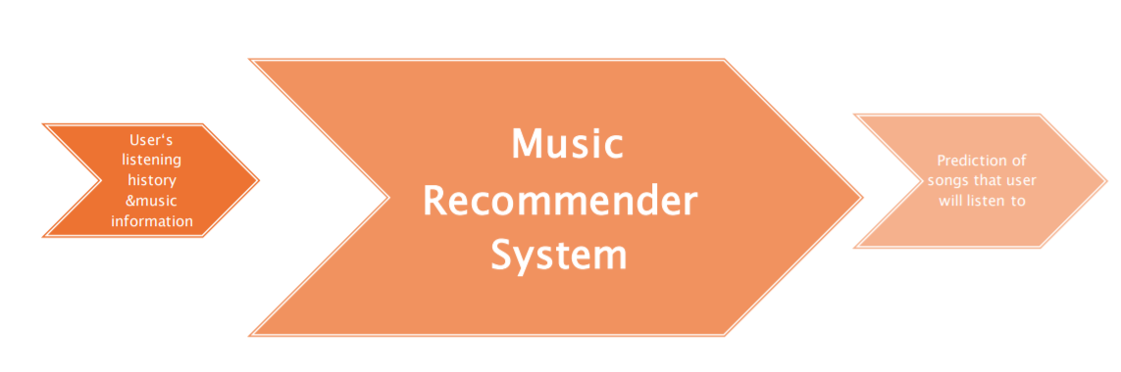
OUR TASK

Slide 6
Tools used
Anaconda (Jupyter notebook)
Visual studio Knime

Slide 7
Data description
The "data.csv" file contains more than 175.000 songs collected from Spotify Web API, and also you can find data grouped by artist, year, or genre in the data section. More on Spotify audio features. More on other Spotify track features
Primary:
- id (Id of track generated by Spotify)
Numerical:
- acousticness (Ranges from 0 to 1)
- danceability (Ranges from 0 to 1)
- energy (Ranges from 0 to 1)
- duration_ms (Integer typically ranging from 200k to 300k)
- instrumentalness (Ranges from 0 to 1)
- valence (Ranges from 0 to 1)

Slide 8
DATASET description
popularity (Ranges from 0 to 100)
- tempo (Float typically ranging from 50 to 150)
- liveness (Ranges from 0 to 1)
- loudness (Float typically ranging from -60 to 0)
- speechiness (Ranges from 0 to 1)
- year (Ranges from 1921 to 2020)
Dummy:
- mode (0 = Minor, 1 = Major)
- explicit (0 = No explicit content, 1 = Explicit content)
Categorical:
- key (All keys on octave encoded as values ranging from 0 to 11, starting on C as 0, C# as 1 and so on…)
- artists (List of artists mentioned)
- release_date (Date of release mostly in yyyy-mm-dd format, however precision of date may vary)
- name (Name of the song)

Slide 9
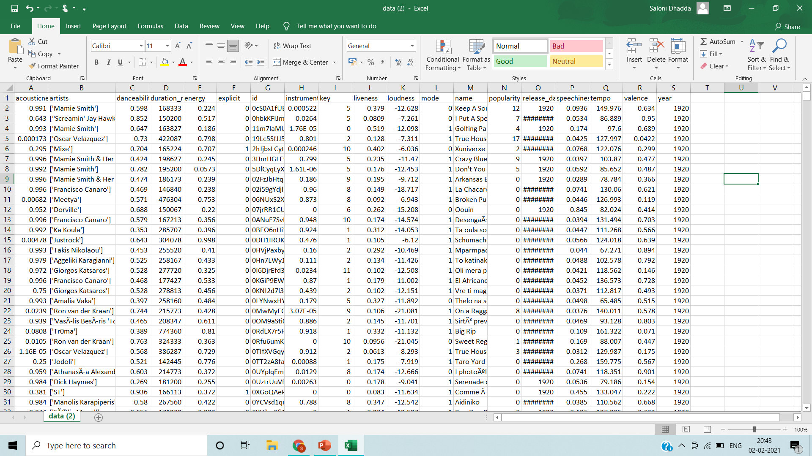

Slide 10
Data preprocessing Tasks performed
Data preprocessing is a data mining technique which is used to transform the raw data in a useful and efficient format. Importing libraries
As main libraries, We are using Pandas, Numpy and time; Pandas: Use for data manipulation and data analysis. Numpy: a fundamental package for scientific computing with Python. As for the visualization We are using Matplotlib and Seaborn.
For the data preprocessing techniques and algorithms, we have used Scikit-learn libraries.

Slide 11
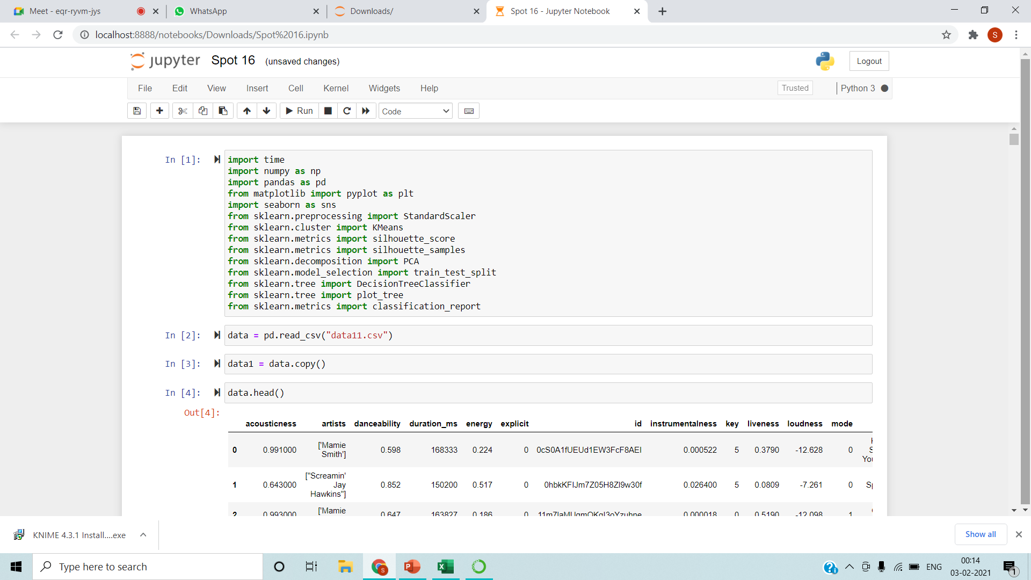
3.Read data Import dataset using pandas library

Slide 12
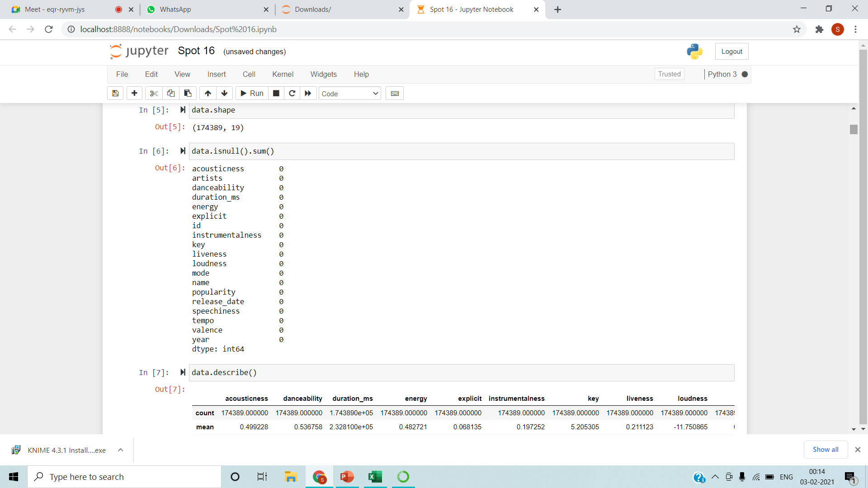
4.check for missing values df.isnull().any().sum()
If any missing value found fill it using different methods.
Fillna(0)
Fillna,(99)
Fill it using simple imputer using mean ,median and most frequent.
Else drop the null value rows using dropna.

Slide 13
Data mining techniques applied
Data mining is highly effective, so long as it draws upon one or more of these techniques.
Both K means & K modes Clustering techniques are applied on the dataset .
The Rain Forest Algorithm is applied as it give the best accuracy as compared to Support vector machine, Logarithm Regression, Linear Regression & Decision Tree.
In Clustering k means and K modes are applied and K Means is a better choice.

Slide 14
K-Means Clustering Algorithm
The problem is computationally difficult ; however, efficient heuristic algorithms converge quickly to a local optimum. These are usually similar to the expectation-maximization algorithm for mixtures of Gaussian distributions via an iterative refinement approach employed by both k-means and Gaussian mixture modeling. They both use cluster centers to model the data; however, k-means clustering tends to find clusters of comparable spatial extent, while the expectation-maximization mechanism allows clusters to have different shapes.
The unsupervised k-means algorithm has a loose relationship to the k-nearest neighbor classifier, a popular supervised machine learning technique for classification that is often confused with k-means due to the name. Applying the 1-nearest neighbor classifier to the cluster centers obtained by k-means classifies new data into the existing clusters. This is known as nearest centroid classifier.

Slide 15
Random Forest Algorithm
Random forest is a supervised learning algorithm.
Random forests or random decision forests are an ensemble learning method for classification, regression and other tasks that operate by constructing a multitude of decision trees at training time and outputting the class that is the mode of the classes (classification) or mean/average prediction (regression) of the individual trees
Random decision forests correct for decision trees' habit of overfitting to their training set
Random forests generally outperform decision trees, but their accuracy is lower than gradient boosted trees.
data characteristics can affect their performance though
random forest builds multiple decision trees and merges them together to get a more accurate and stable prediction.

Slide 16
Observations
Mostly 2000 songs are added for each year on spotify
Tracks have become more Energetic and Danceable in the recent years. The loudness and tempo has also increased.
The tracks have become less "Acoustic"
Spotify has 454.06 days of music or 1.24 year of continous listening. In other words it will take 1.24 years for you to listen to all the songs
Valence and Danceability are highly related and so is speechiness and Danceability
The five best predictors of popularity in order of importance are
year;
song duration (the scale of the regression plot of popularity against duration_ms may be confusing, but it shows that most songs are shorter than 16 minutes and that the longer a song is, the more popular it is. (Untrained opinion: this is given the song is less than 16 minutes.);
loudness;
danceability;
speechiness; and
acousticness.

Slide 17
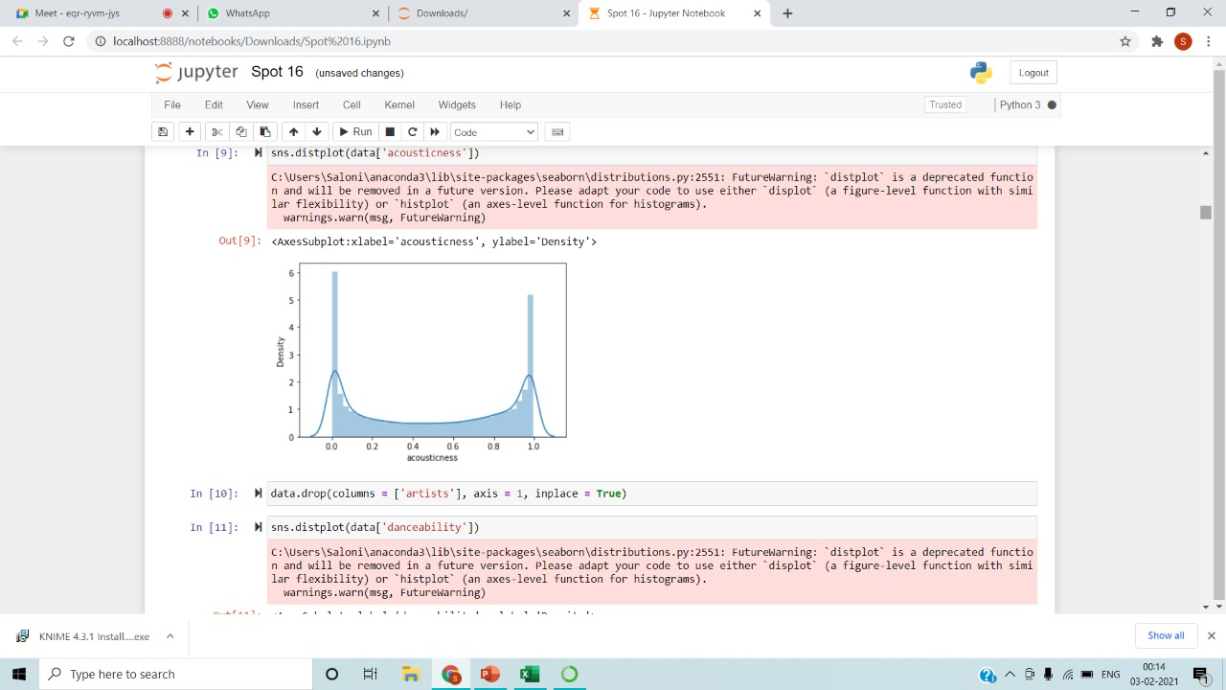
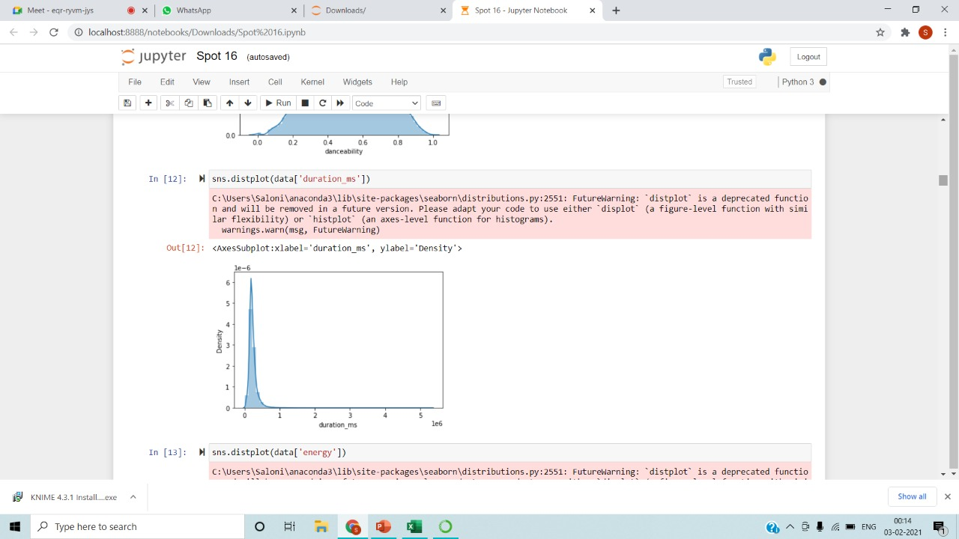
DISPLAY DISTPLOT ON VARIOUS FEATURES

Slide 18
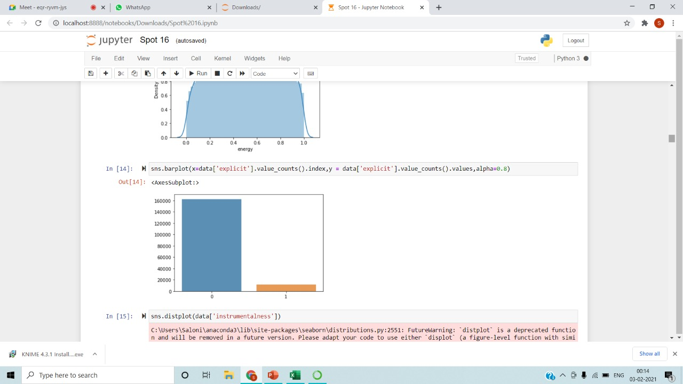
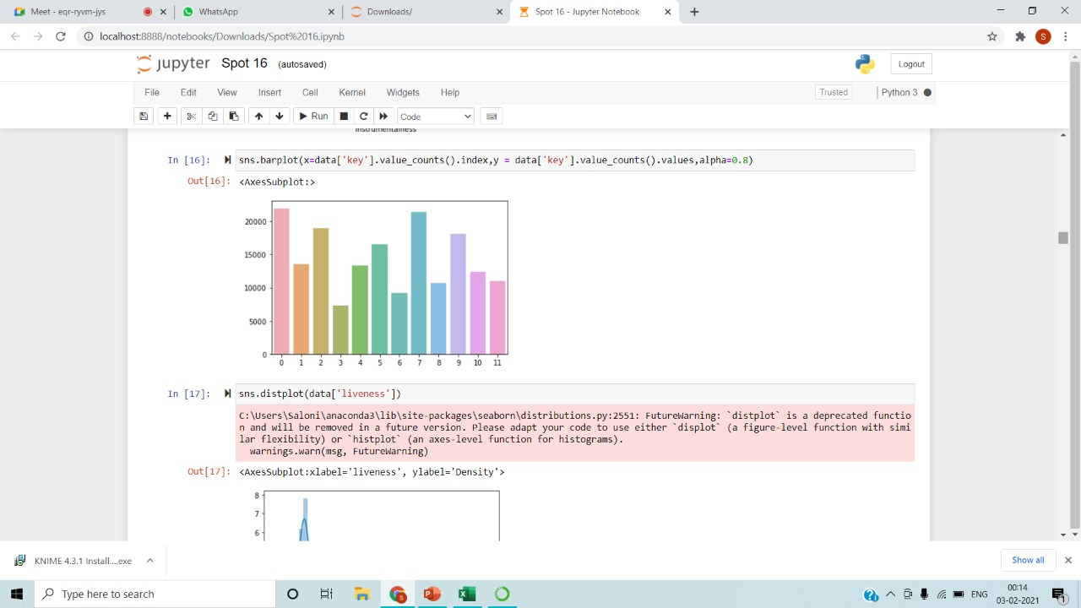
BARPLOTS

Slide 19
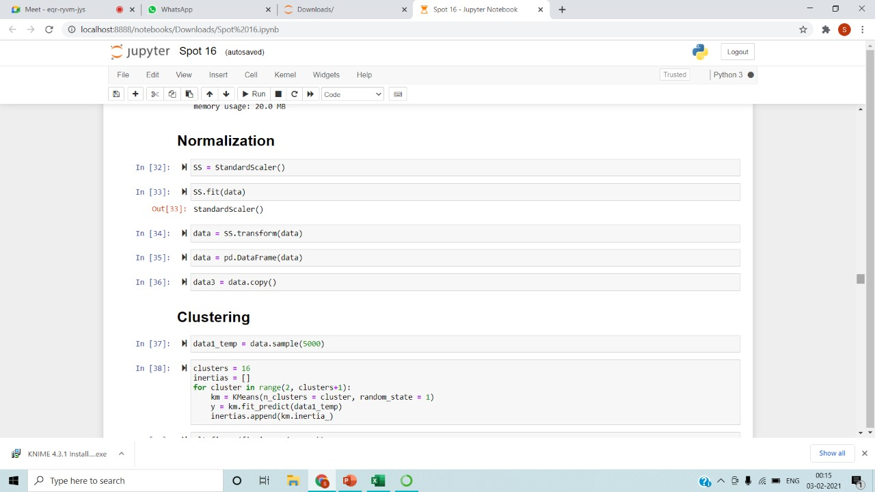
NORMALIZATION AND CLUSTERING

Slide 20
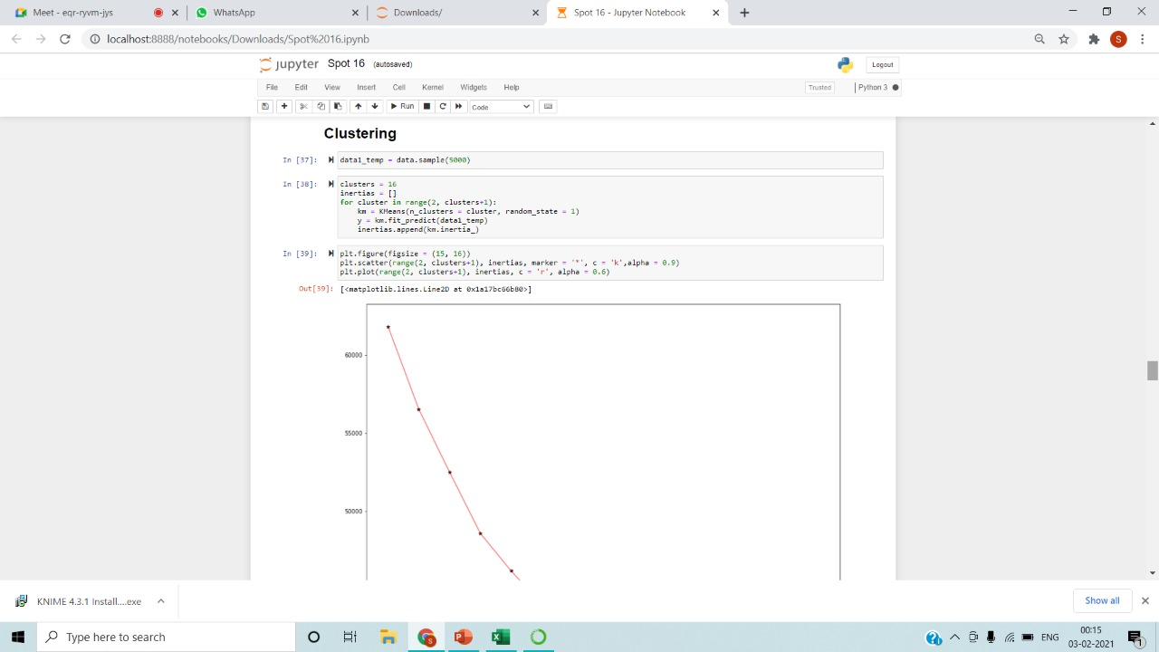
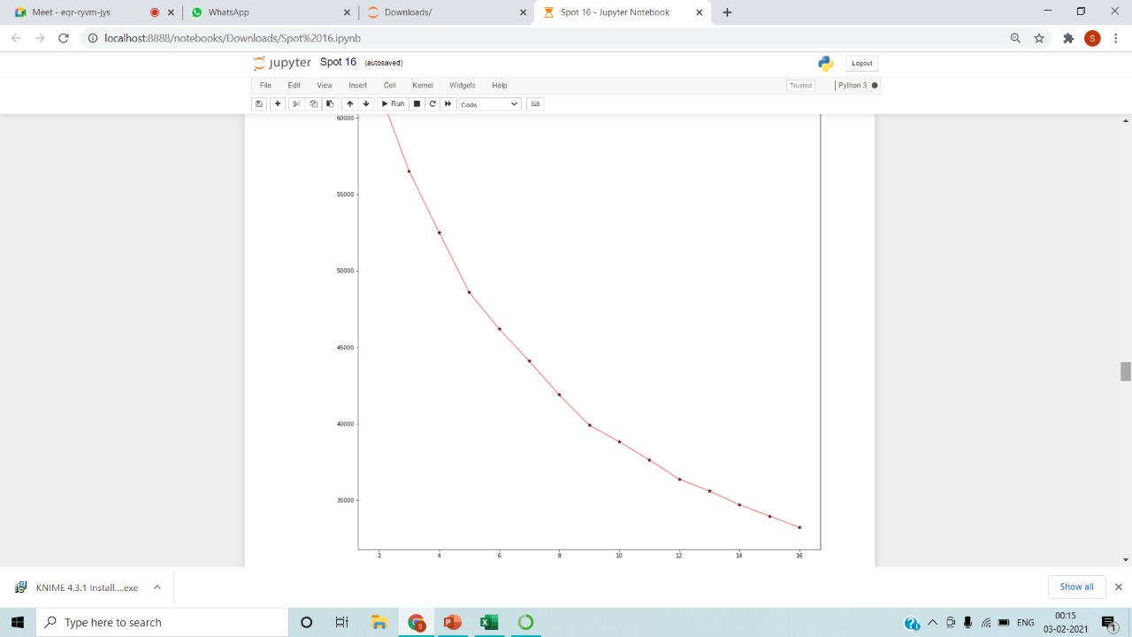
ELBOW METHOD

Slide 21
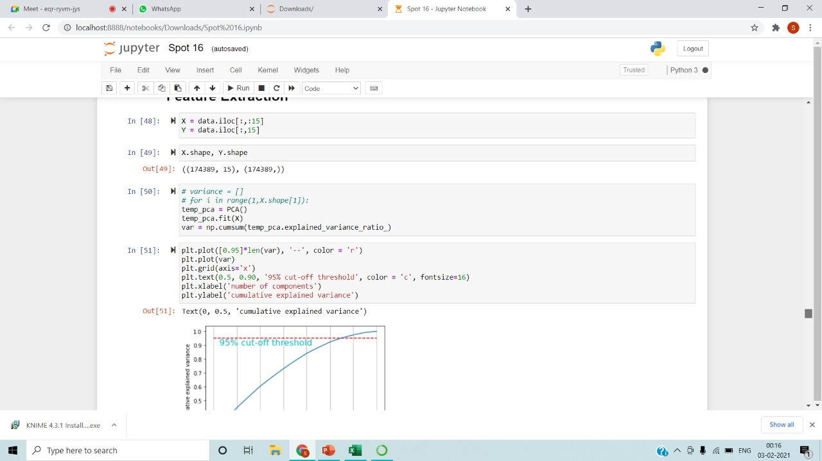
FEATURE SELECTION

Slide 22
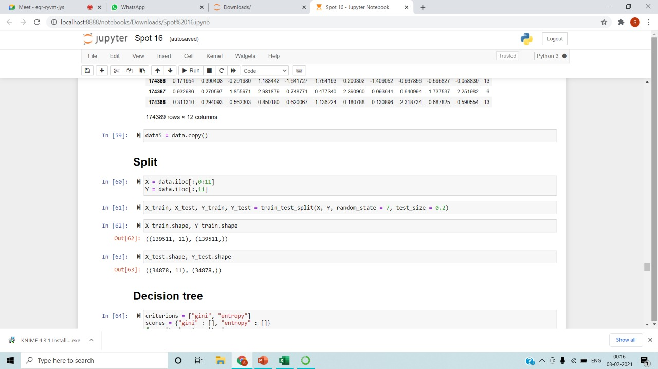
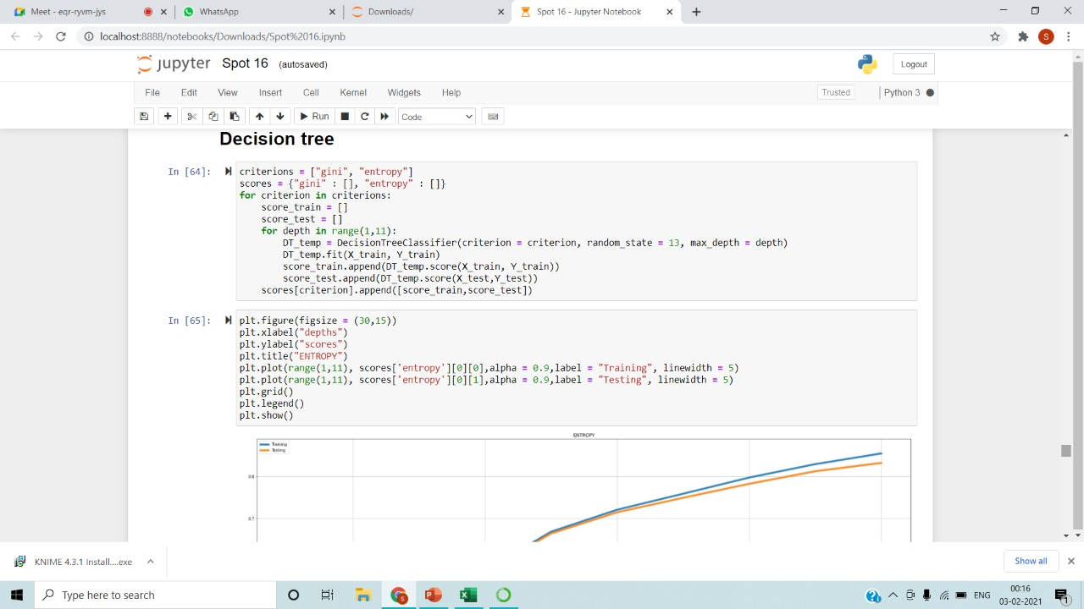
SPLITTING AND DECISION TREE

Slide 23
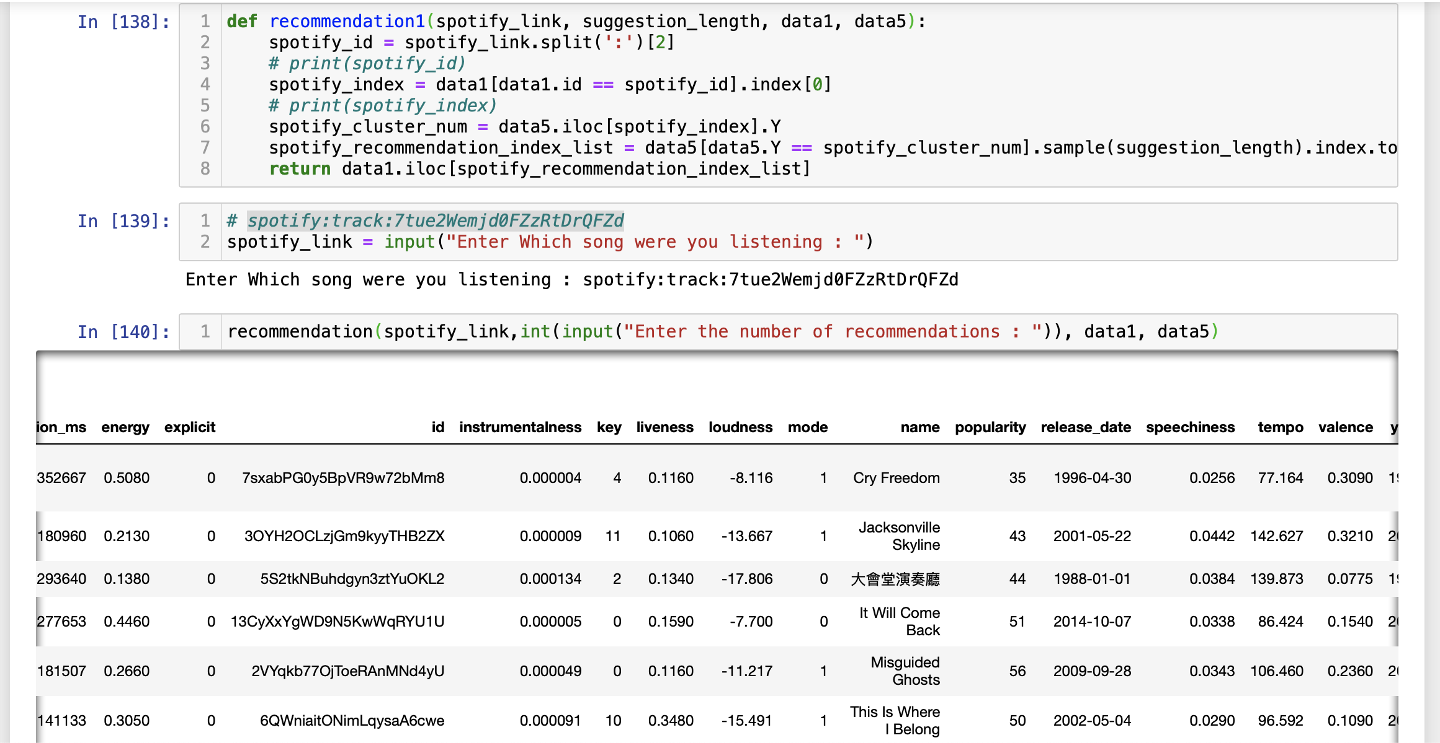
Recommendation System

Slide 24
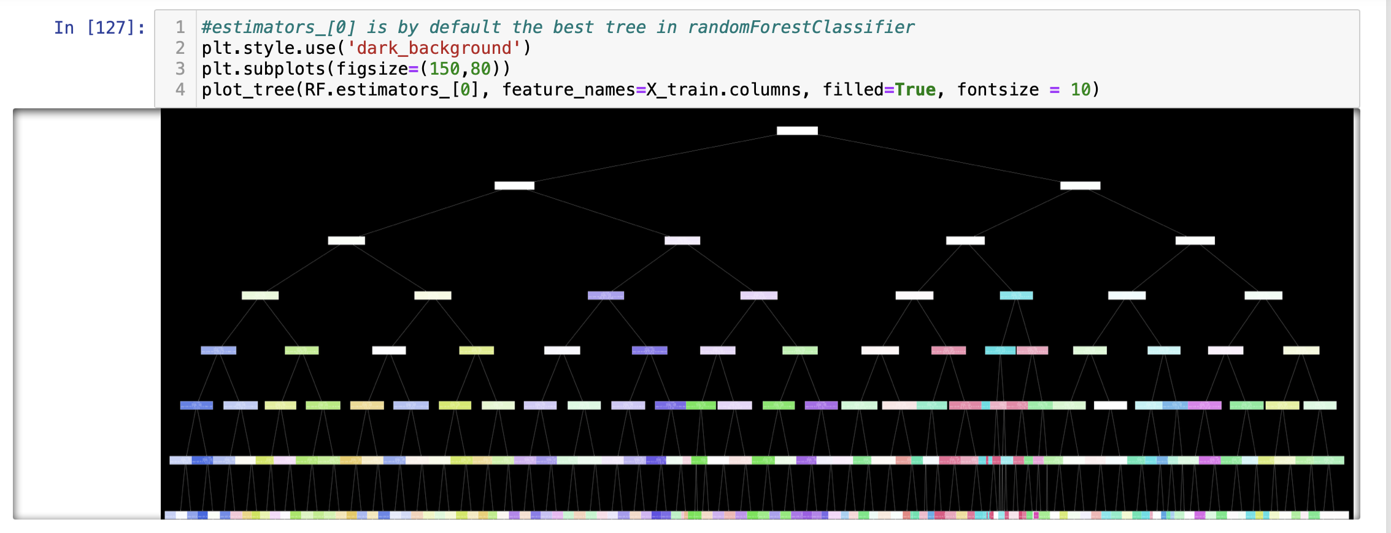
Random forest

Slide 25
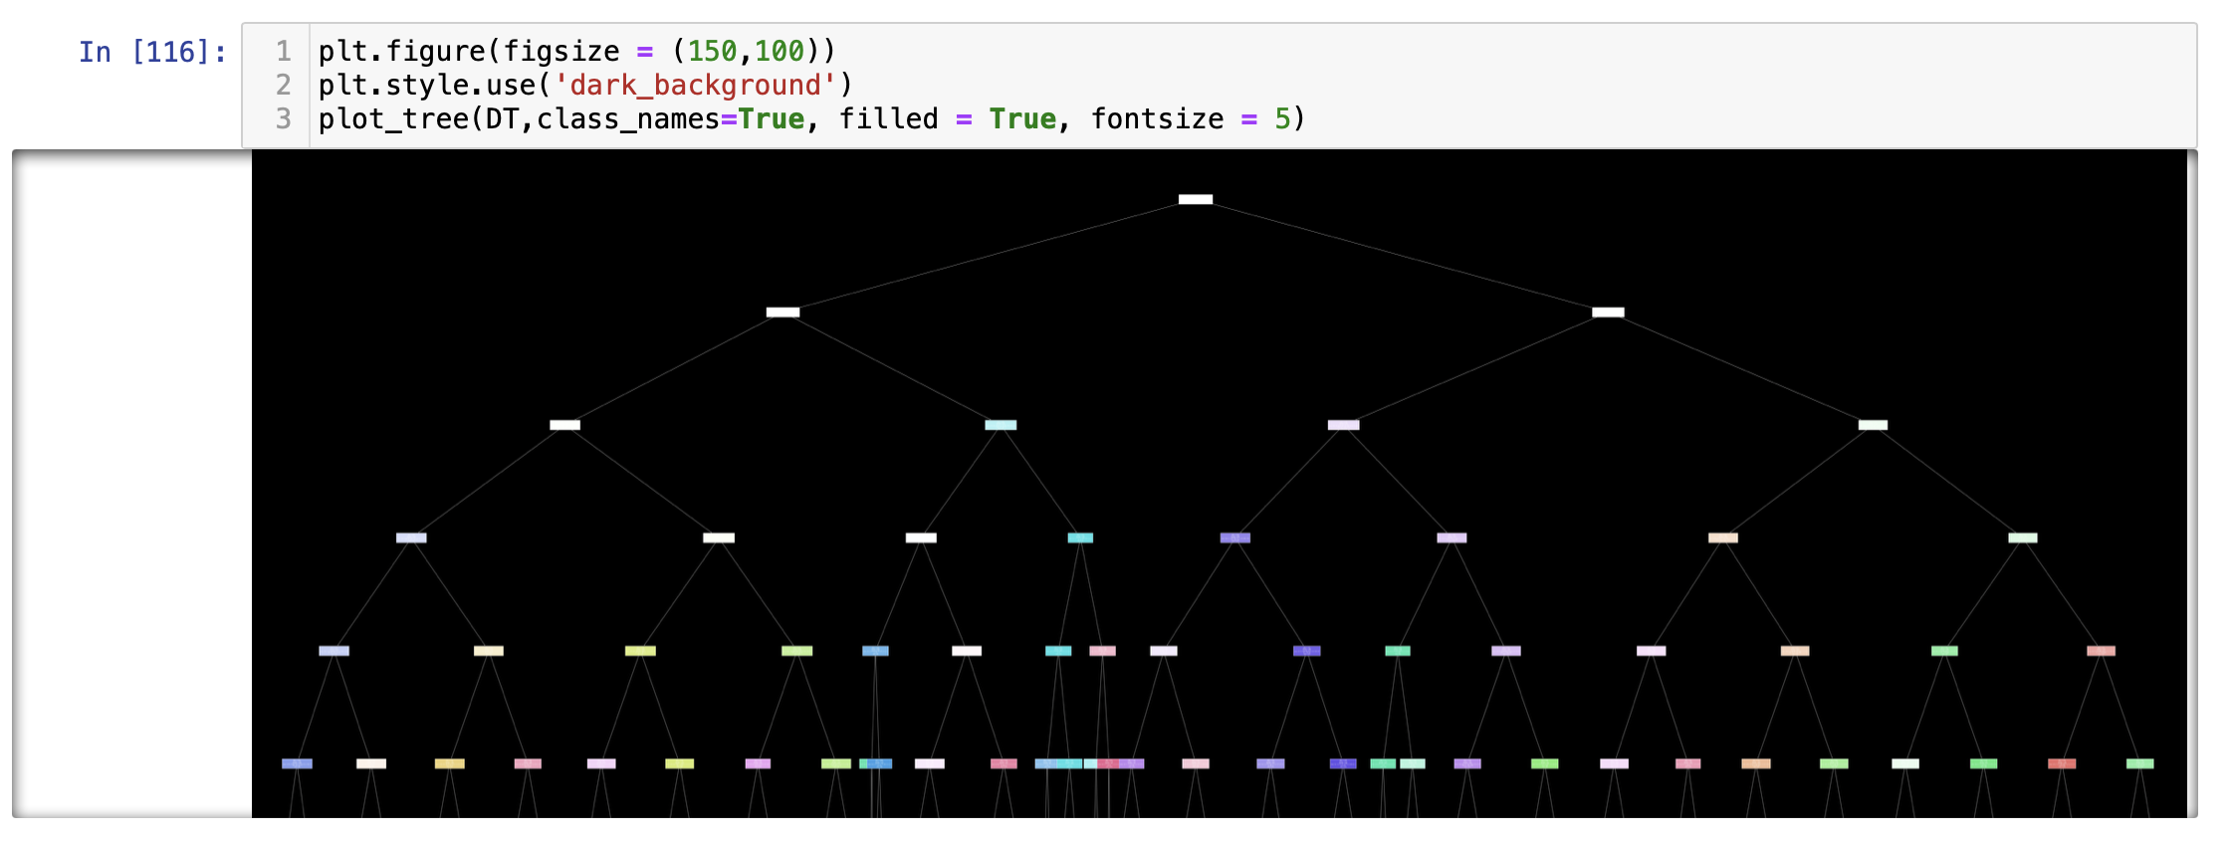
Decision tree

Slide 26
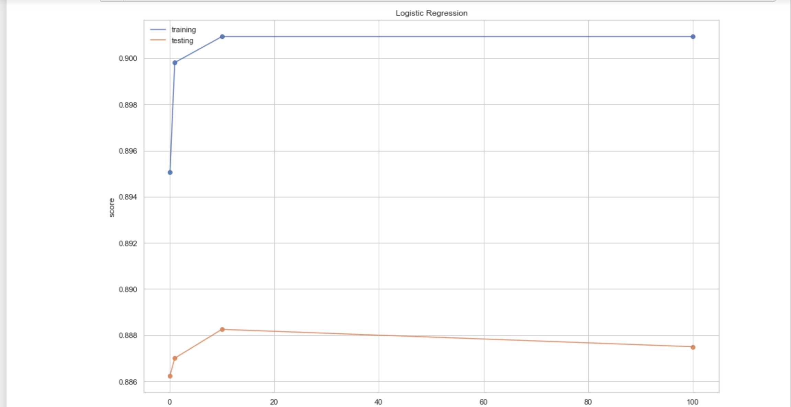
Logistic Regression

Slide 27
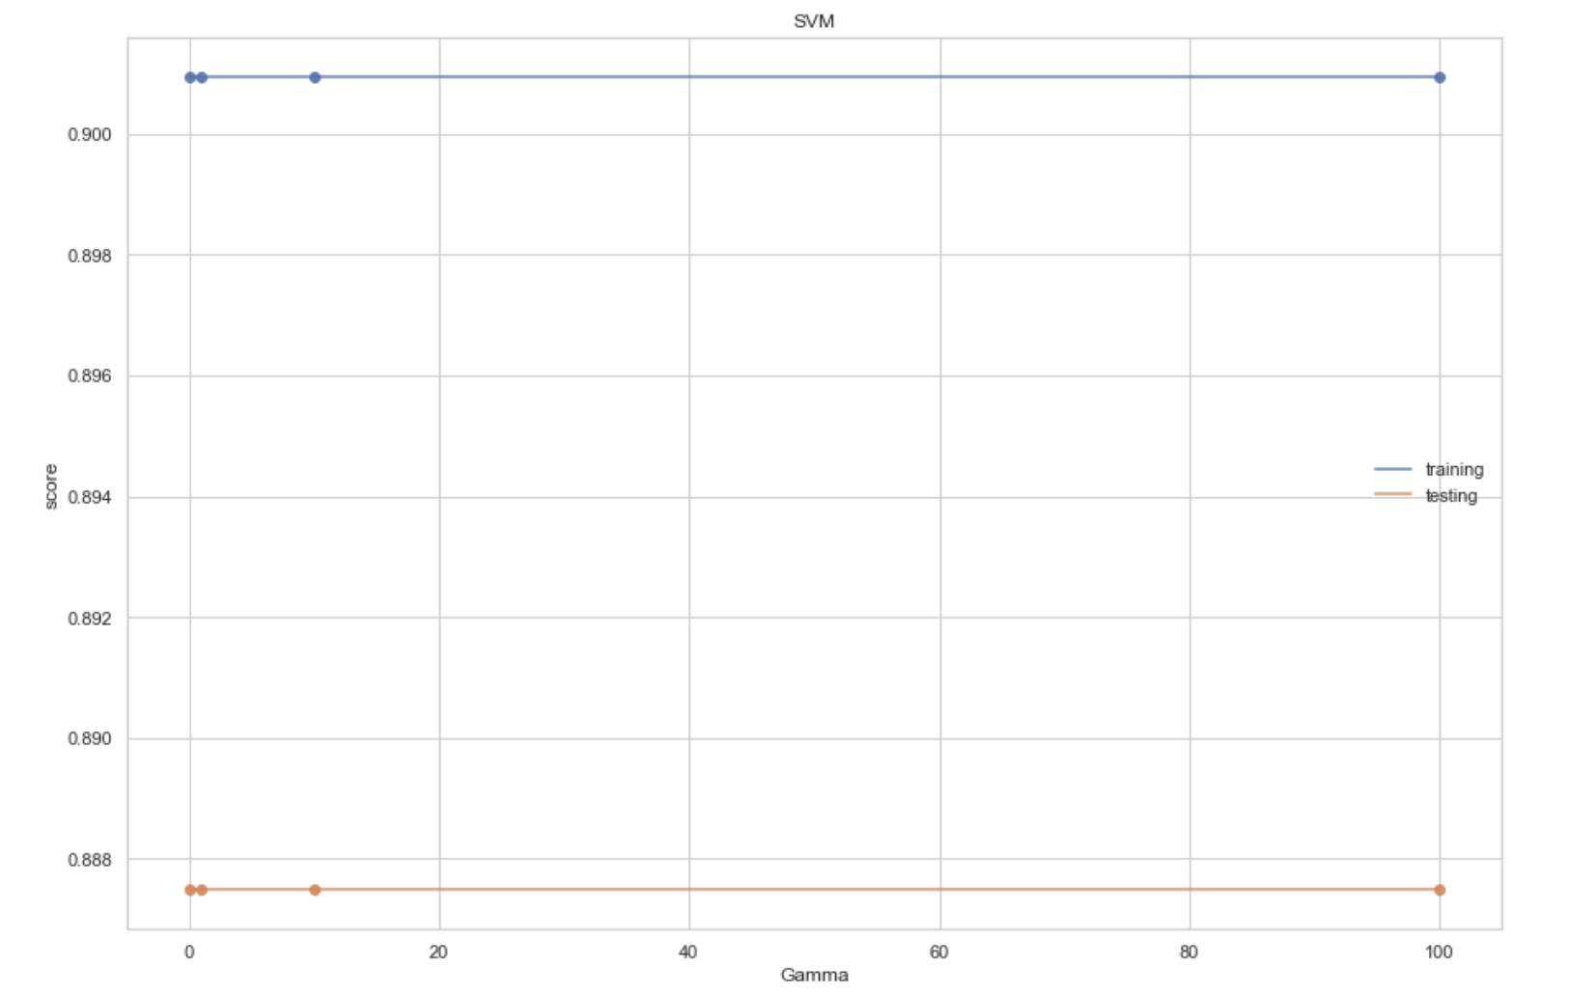
SVM

Slide 28
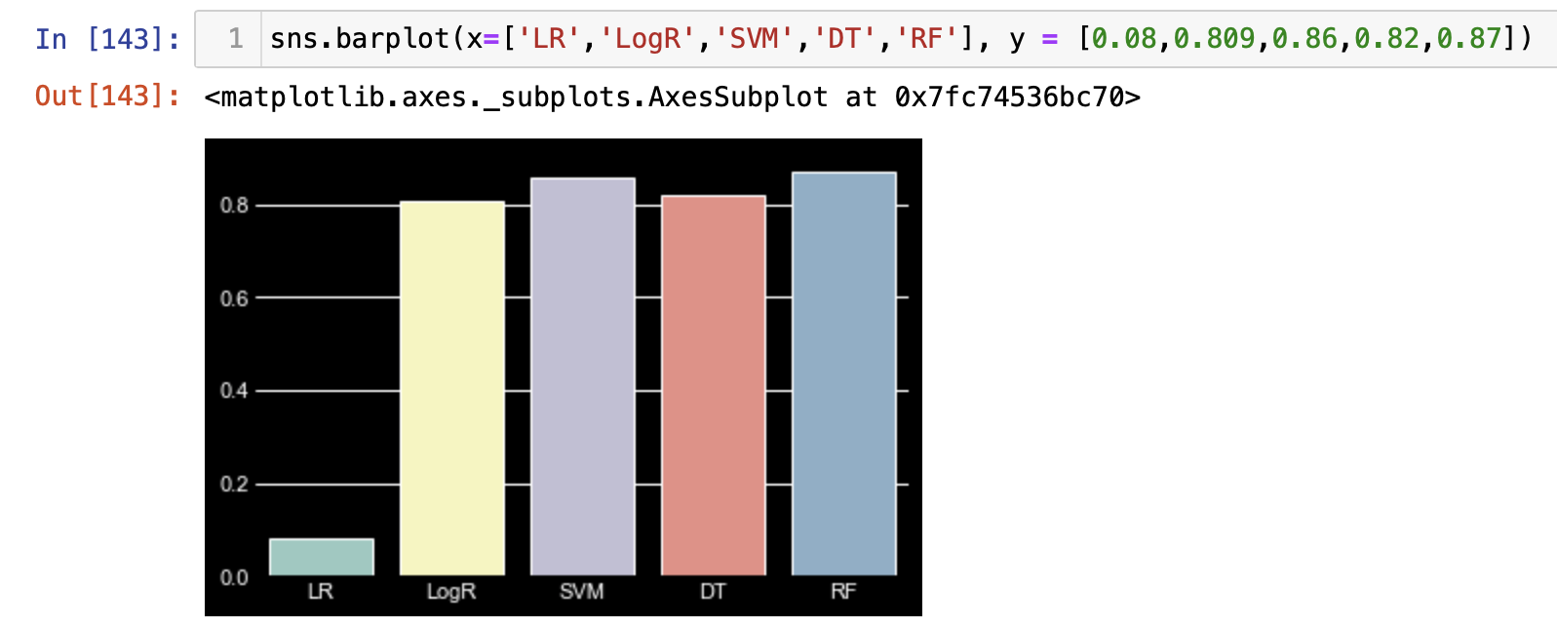
Bar plot on the Winner of Algorithms

Slide 29

KNIME

Slide 30
Dashboard using Knime
Different visualization and data mining techniques are performed using Knime tool.
The classification algorithms are compared based on accuracy and the predictions are shown related to prediction of songs.
K-Means and linear Algorithm are performed and analysis is shown using scatter plot.

Slide 31
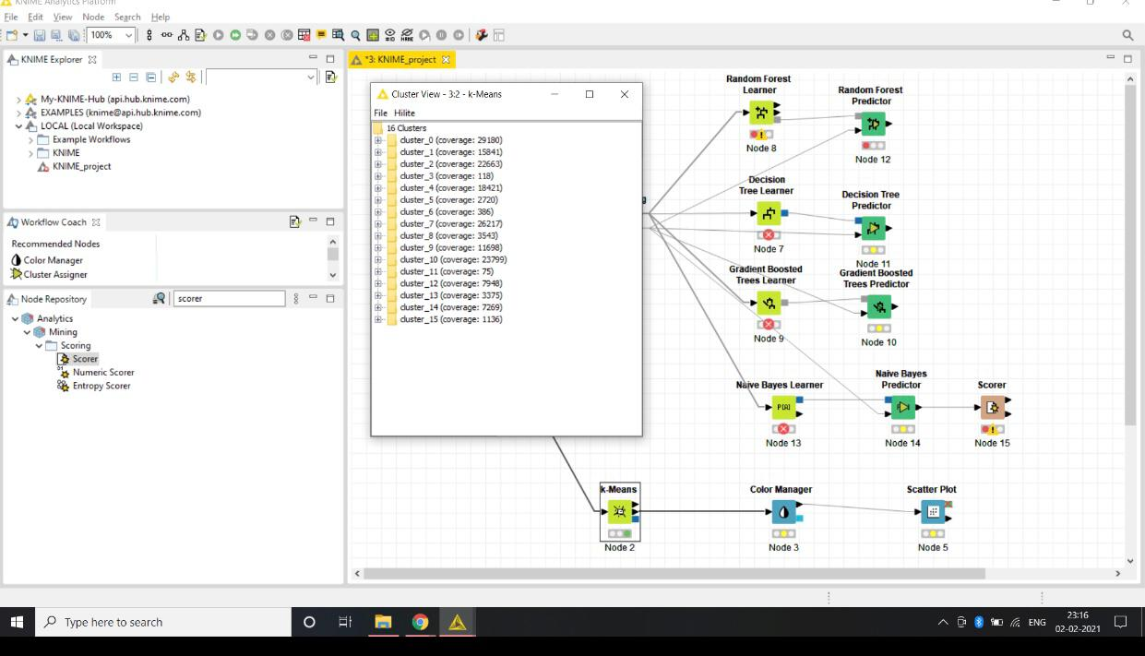
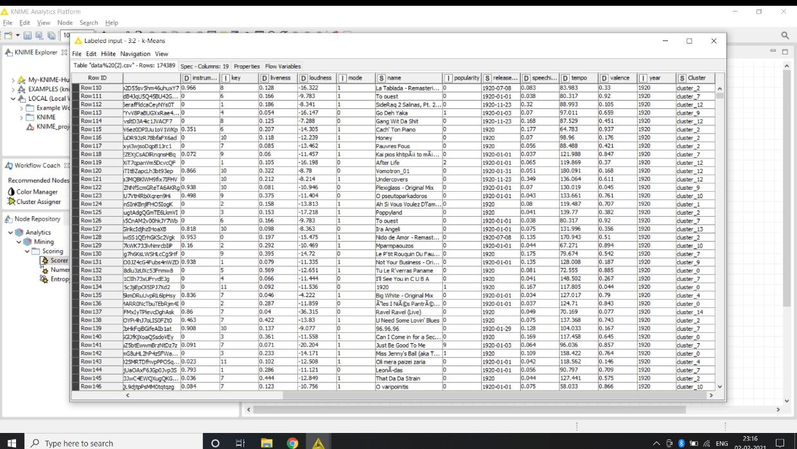
KNIME SCREENSHOTS

Slide 32
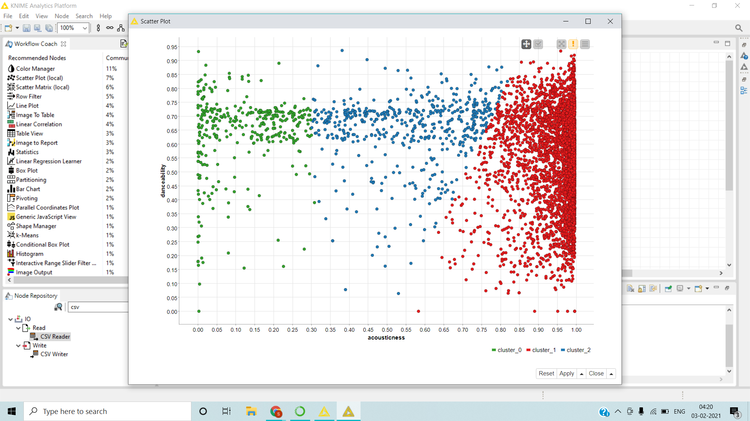
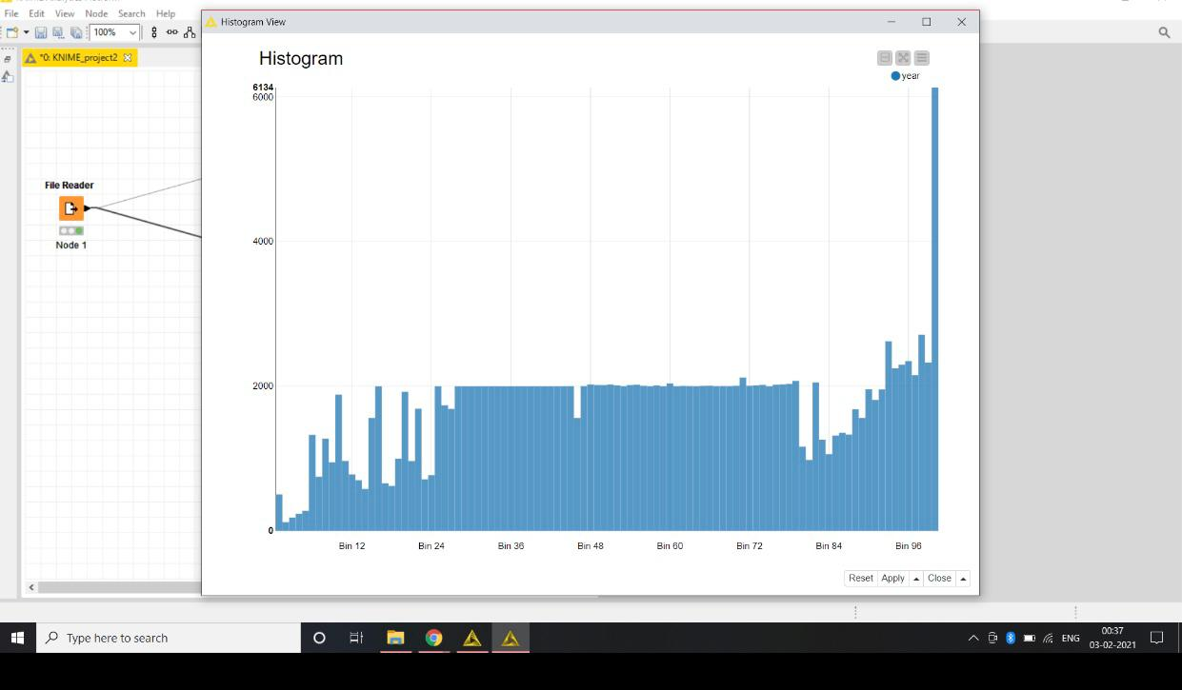
SCATTERPLOT AND histogram

Slide 33
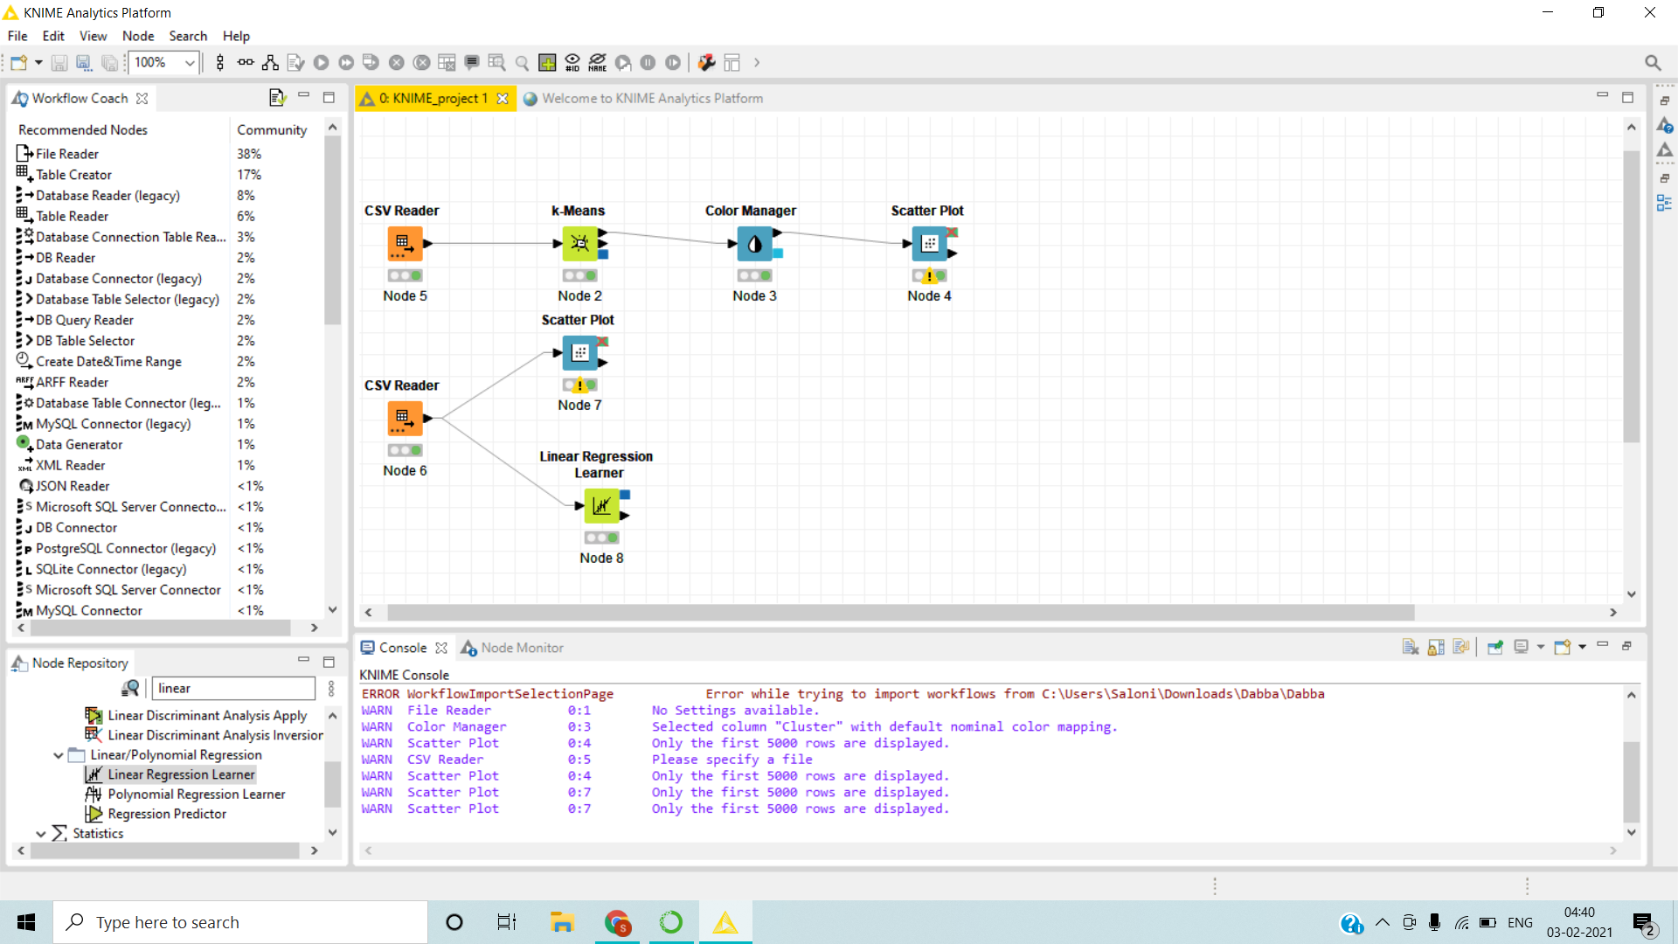
WORKspace

Slide 34
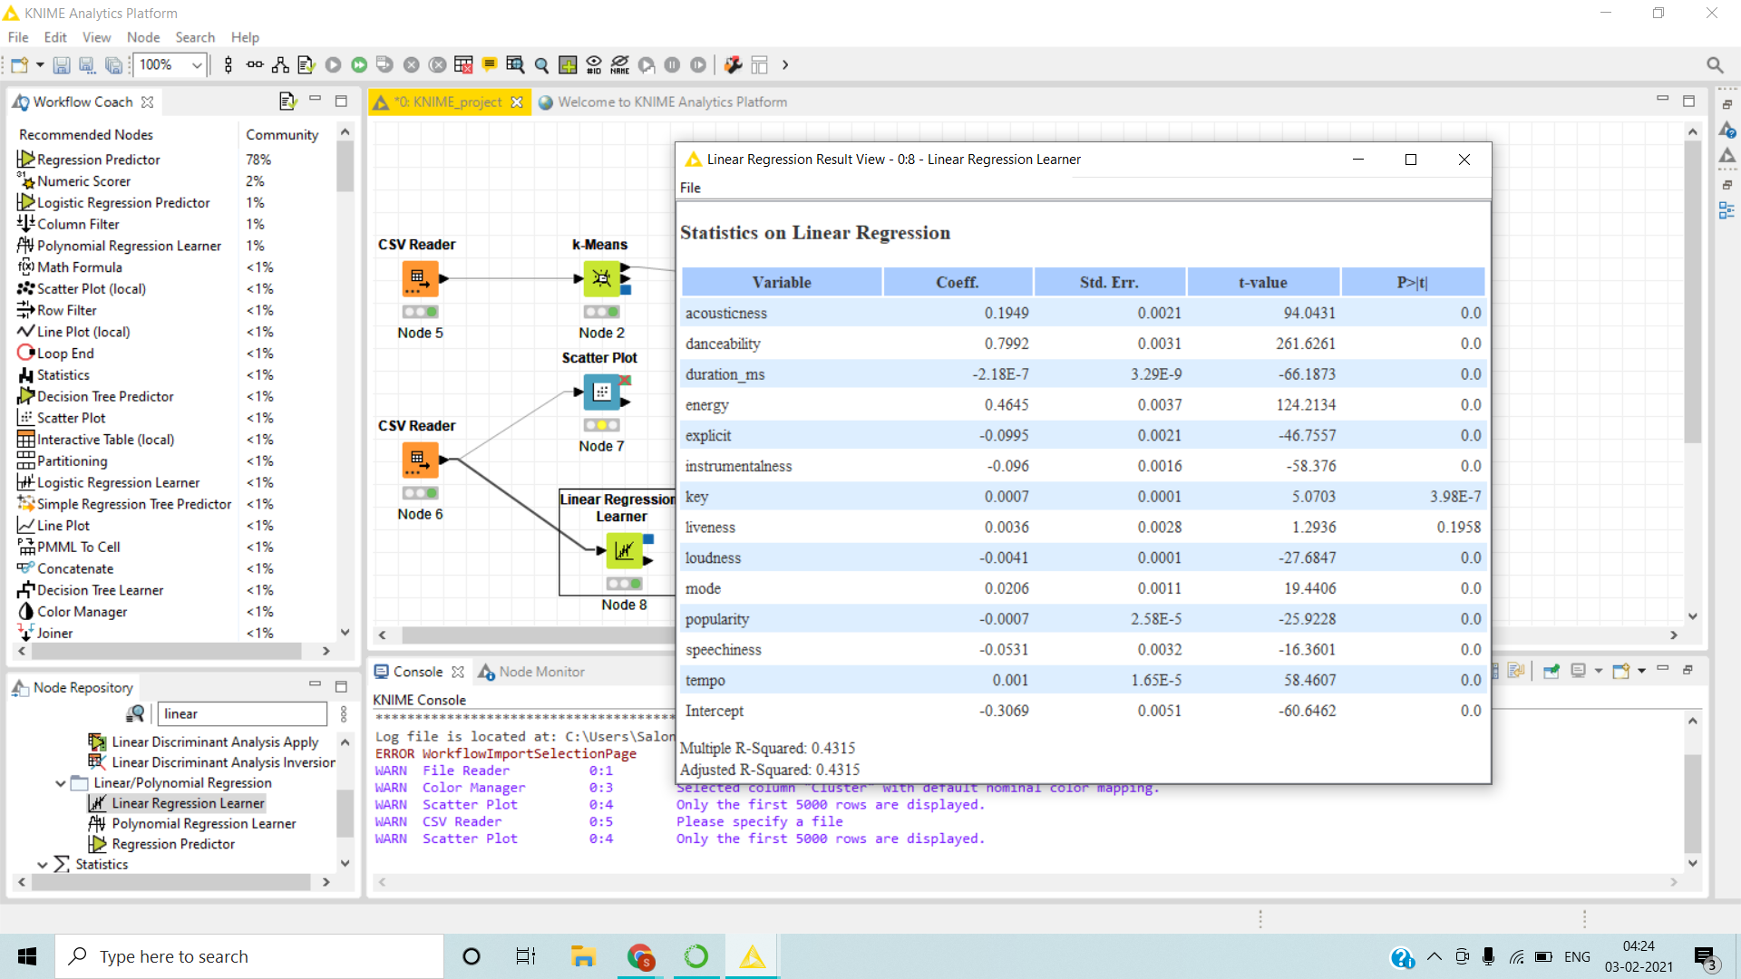
STATISTICS ON LINEAR REGRESSION

Slide 35
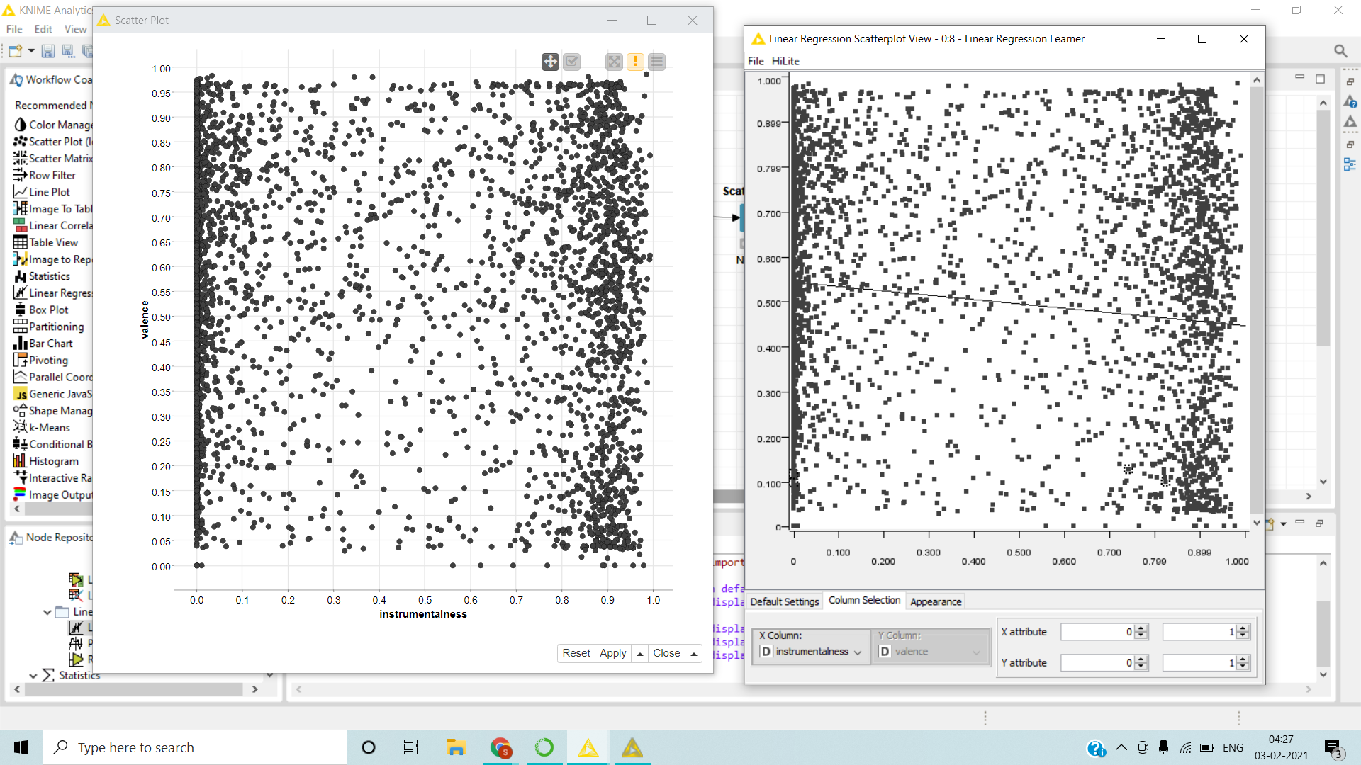
ACTUAL VS PREDICTED

Slide 36
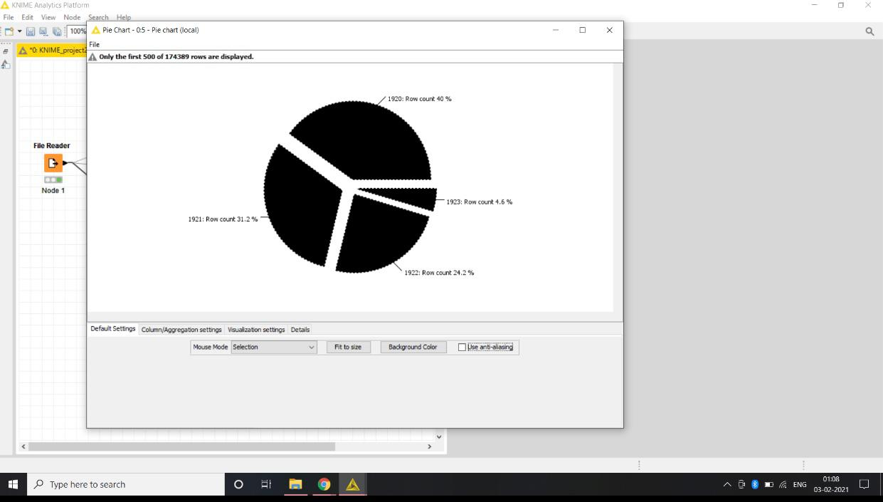
PIECHART

Slide 37
Conclusion
Thus different data mining techniques are applied on dataset and analysis is done based on mood.
After analysis we predicted mood of the song and then recommend songs according to user’s mood.
Different data visualization have also been performed from which useful patterns are extracted.
Same analysis is also performed using Knime tool.

Slide 38
References
https://archive.ics.uci.edu/ml/datasets.php
https://towardsdatascience.com/
https://www.udemy.com/course/datadrivenscience-machinelearning/

